Slide 1
计算机图形学
中国传媒大学动画学院
费广正
gzfei@cuc.edu.cn
18600981098

Slide 2
内容回顾
建模变换
应用程序阶段
顶点着色
视图变换
几何阶段
投影变换
裁剪变换
扫描转换
像素着色
光栅阶段
可见性判定

Slide 3
第10讲 可见性判定Culling Techniques
“To cull” means “to select from group”
In graphics context: do not process data that will not contribute to the final image
The “group” is the entire scene, and the selection is a subset of the scene that we do not consider to contribute
Notes:
If you look up the word CULL in a DICTIONARY...
What’s it all about: do NOT send geometry through the pipeline if it does not contribute to the final image
Reason: Z-buffer is NOT very smart -- every pixel can be unnecessarily overdrawn several times

Slide 4
Culling: Overview
Backface culling
Hierarchical view-frustum culling
Portal culling
Detail culling
Occlusion culling
Notes:
Next slides shows some examples

Slide 5
Culling examples
view frustum
detail
backface
portal
occlusion

Slide 6
Backface Culling
Simple technique to discard polygons that faces away from the viewer
Can be used for:
  closed surface (example: sphere)
  or whenever we know that the backfaces never should be seen (example: walls in a room)
Two methods (screen space, eye space)
Which stages benefits?
  Rasterizer, Geometry (where test is done)
Notes:
If looking at an OPAQUE SPHERE, approximately 50% will be invisible

Slide 7
Backface culling (cont’d)
Often implemented for you in the API
OpenGL: glCullFace(GL_BACK);
How to determine what faces away?
First, must have consistently oriented polygons, e.g., counterclockwise
2
2
0
1
0
front facing
back facing
1
Notes:
For all culling techniques: it is important do try to CULL as early in the PIPELINE as possible.
To be able to use BF CULL, we need to understand how it works

Slide 8
How to cull backfaces
1
2
back
2
eye
1
0
front
0
front
back
screen space
eye space
Notes:
SCREEN=SPACE test is often safer
BECAUSE a slightly forward facing polygon can become backwards in screen space due to rounding

Slide 9
View-Frustum Culling
Bound every “natural” group of primitives by a simple volume (e.g., sphere, box)
If a bounding volume (BV) is outside the view frustum, then the entire contents of that BV is also outside (not visible)
Avoid further processing of such BV’s and their containing geometry
Notes:
Happens early (on CPU) in the pipeline == GOOD

Slide 10
Can we accelerate VF culling further?
Do what we always do in graphics…
Use a hierarchical approach, e.g, the scene graph
Which stages benefits?
  Geometry and Rasterizer
  Bus between CPU and Geometry
Notes:
Example: if the ROOT is OUTSIDE, then we’re done, don’t need to render or traverse further
Another example: imagine walking around in a CITY, a lot of GEOMETRY will be CULLED, for example, everything BEHIND the viewer
So, this is one way of using the scene graph
VF CULL: often used as an algorithm to compare performance, i.e., our algorithm is 10x faster than VF cull
NEXT SLIDE shows an example of a hierarchy

Slide 11
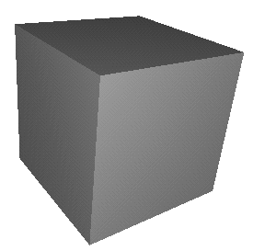
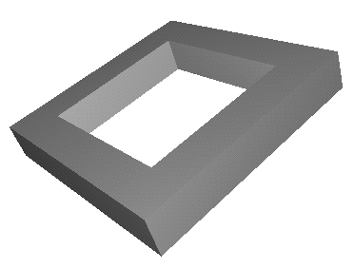
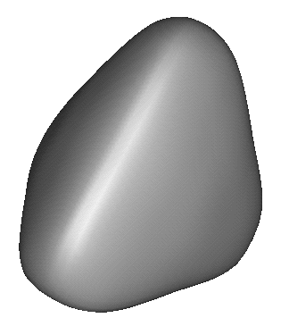
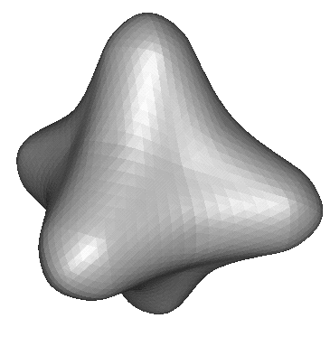
Example of Hierarchical View Frustum Culling
root
camera
Notes:
Assuming that testing a sphere against the view frustum is cheaper than rendering the object

Slide 12
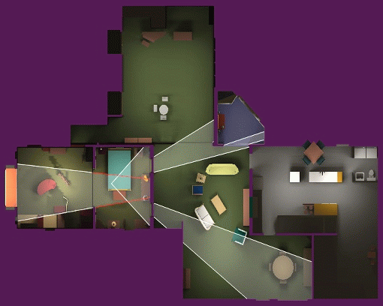
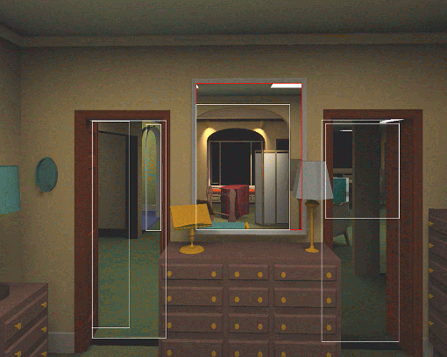
Portal Culling
Average: culled 20-50% of the polys in view
Speedup: from slightly better to 10 times
Notes:
IDEA:
REFINED VIEW FRUSTUM CULLING : frustum gets smaller for each door (portal) we look through
EXAMPLE:through doors in a building
mostly good for indoor scenes only

Slide 13
Portal culling example
In a building from above
Circles are objects to be rendered

Slide 14
Portal Culling Algorithm
Divide into cells with portals (build graph)
For each frame:
  Locate cell of viewer and init 2D AABB to whole screen
  * Render current cell with VF cull w.r.t. AABB
  Traverse to closest cells (through portals)
  Intersection of AABB & AABB of traversed portal
  Goto *
Notes:
CELLS == ROOMS
PORTALS == DOORS or WINDOWS

Slide 15
Portal overestimation
To simplify:
actual portal
overestimated portal
Notes:
In reality the actual portals are almost never AXIS-ALIGNED after projection
LEFT: an example
Solution: bound with an AABB, that is, overestimate the portal
WHY: to make intersection between AABBs fast and simple

Slide 16
Portal Culling Algorithm
When to exit:
  When the current AABB is empty
  When we do not have enough time to render a cell (“far away” from the viewer)
Also: mark rendered objects
Which stages benefits?
  Geometry, Rasterizer, and Bus
Source (for Performer): http://www.cs.virginia.edu/~luebke/
Notes:
MARK OBJECTS: because an object might be seen through 2 different portals
AND we do not want to render them TWICE

Slide 17
Detail Culling
Idea: objects whose projected BV occupy less than N pixels are culled
This is an approximative algorithm as the things you cull away may actually contribute to the final image
Advantage: trade-off quality/speed
Which stages benefits?
  Geometry, Rasterizer, and Bus
Notes:
Also, called SCREEN-SIZE CULLING
Bullet 2: This implies that this is an approximation….forts slide
Bullet 3: higher speed if larger threshold (N)
Often combined with Hierarchical VF CULL,
that is, DONE in a hierarchical fashion as well

Slide 18
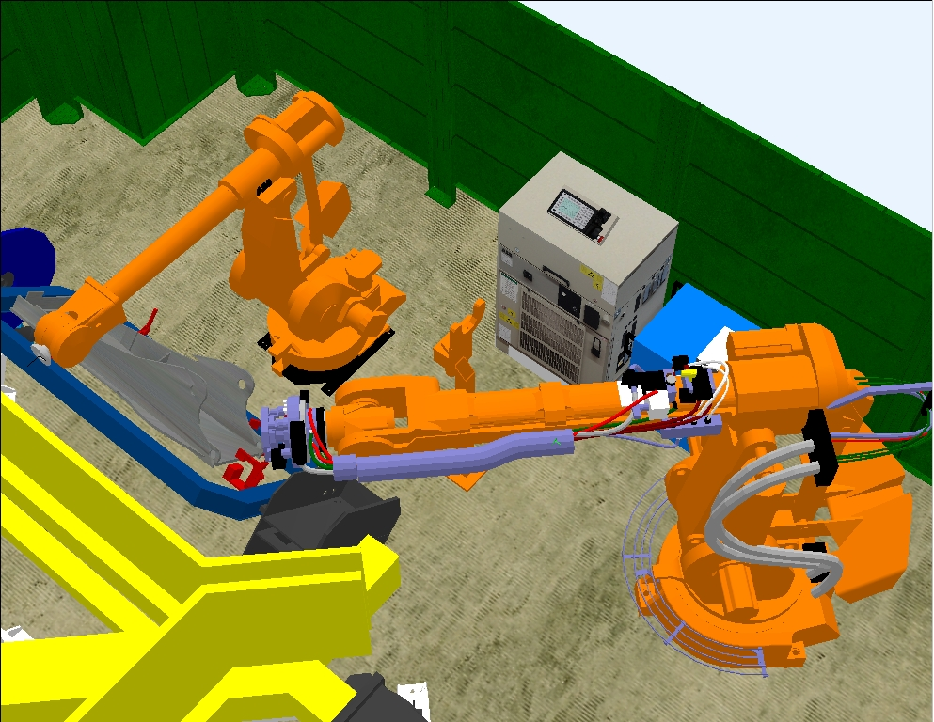

Example of Detail Culling
Images courtesy of ABB Robotics Products, created by Ulf Assarsson
detail culling OFF
detail culling ON
Not much difference, but 80-400% faster
Good when moving

Slide 19
Projection
eye
Projection gets halved when distance is doubled
Notes:
BVs == SPHERES
Main observation that we use to derive a formula

Slide 20
Projection (cont’d)
d (normalized view direction)
(eye) v
r
c
(near plane) n
dot(d, (c-v)) is distance along d
p=nr/dot(d, (c-v)) is estimation of projected radius
πp² is the area
Notes:
PI * p * p < N then SKIP object
More in RTR book

Slide 21
Occlusion Culling
Main idea: Objects that lies completely “behind” another set of objects can be culled
Hard problem to solve efficiently
Notes:
There are many algorithms for occlusion culling (two new papers at SIGGRAPH from MIT).
I believe that different algorithms should be used for different environments,
so for example: very different circumstances indoors/outdoors/forest/etc

Slide 22
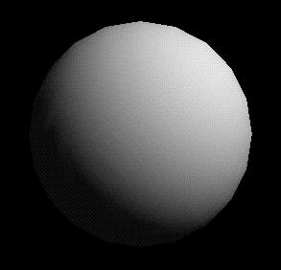
Example
final image
Note that “Portal Culling” is an algorithm for occlusion culling
Notes:
NAÏVE EXAMPLE
4 spheres place on a line, viewer looking along this line
STILL, all 4 spheres are rendered
Other DENSELY OCCLUDED ENVIRONMENTS:
Forest
Skyscraper
City

Slide 23
Occlusion culling algorithm
Use some kind of occlusion representation O_{R}
for each object g do:
if( not Occluded(O_{R} ,g))
render(g);
update(O_{R} ,g);
end;
end;
Notes:
On a higher level, most OC algorithms work like this.
The trick of OC: to find simple occlusion representations, which can merge occluders rapidly

Slide 24
Occlusion culling algorithm example
Process from front to back
Maintain an occlusion horizon (yellow)
Notes:
NOTE, for all occlusion culling algorithms, DRAWING ORDER matters!
Front to back gives better performance, in general
We use a simple piecewise-constant occlusion horizon
Occlusion horizon is a conservative estimate of how much the drawn geometry occludes

Slide 25
Occlusion culling algorithm example
To process tetrahedron (which is behind grey objects):
  find axis-aligned box of projection
  compare against occlusion horizon
culled
Notes:
So, we overestimate the projected area of the tetrahedron
Therefore, we will NOT cull away visible objects

Slide 26
Occlusion culling algorithm example
When an object is considered visible:
Add its “occluding power” to the occlusion representation
Notes:
Have to be careful when to add occluding power, and when to test objects for occlusion

